Slide 1
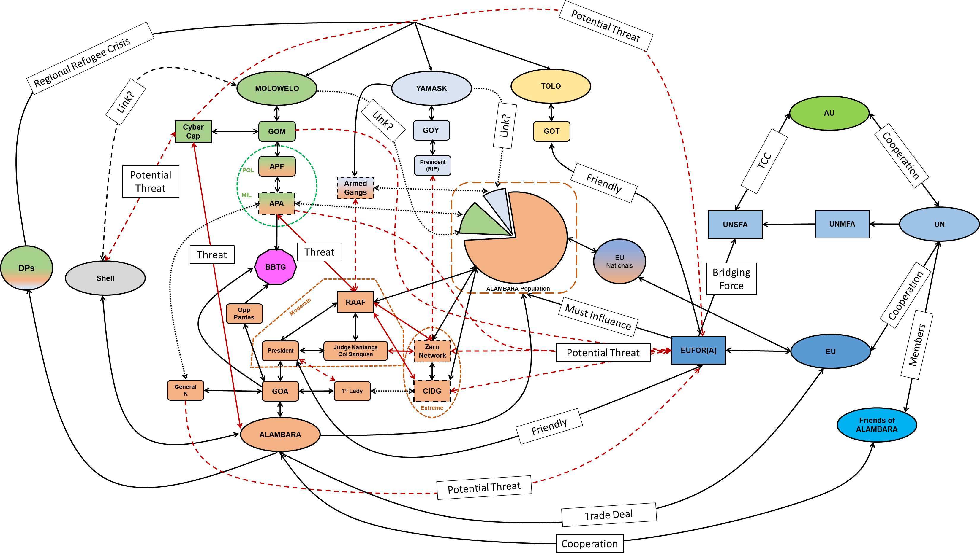

Slide 2
Reassure
Quelo
Maintain
1st Lady
Persuade
Manori
CIDG
Discredit
Persuade & Reassure
GOA
President
Int Comm
RAAF
Uvembi
GOM
W YAM
Discredit
IDPs
APA
APF
GOT
CHINA
Influence
Armed Gangs
Zero Network
S MOL
Friendly
Neutral
Hostile

Slide 3
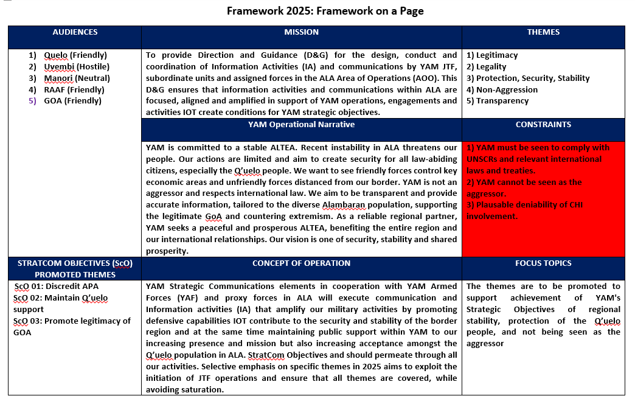

Slide 4
What did Molowelo say to Alambara at Halloween?
Where's Yamask?

Slide 5
